Slide 1

The National University of Computer and Emerging Sciences
Repetition structures
CS 1002 Programming Fundamentals
Dr. Akhtar Jamil
Department of Computer Science

Slide 2
Goals
Review Of Previous Lecture
Repetition structures
While
Do – While
For
Nesting

Slide 3
Previous Lecture

Slide 4
Loops
Counter-controlled Loops
Depends on the value of a variable known as counter variable. The counter is changed (increased/decreased) in each iteration.
Example: for loop
Conditional loop
A conditional loop keeps repeating until a specific condition is met
Example: while and do loops

Slide 5
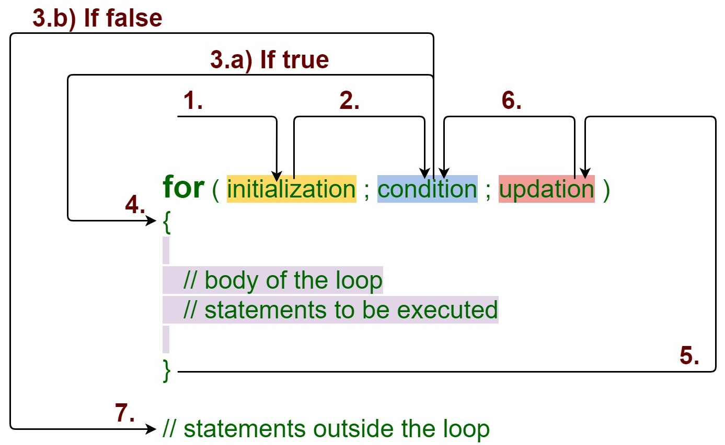
for Loop
https://media.geeksforgeeks.org/wp-content/uploads/20191108131134/For-Loop.jpg

Slide 6
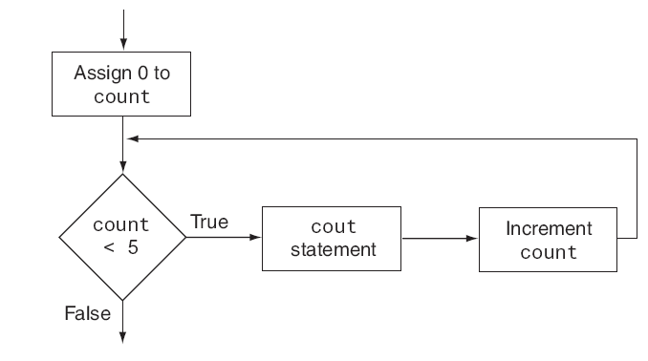
for Loop

Slide 7
Today’s Lecture

Slide 8
while loop

Slide 9
while loop
for loop does something a fixed number of times.
If you don’t know how many times you want to do something before you start the loop?
In this case a different kind of loop may be used: the while loop

Slide 10
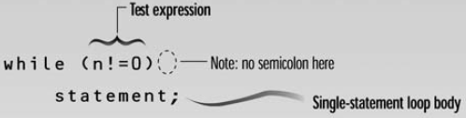
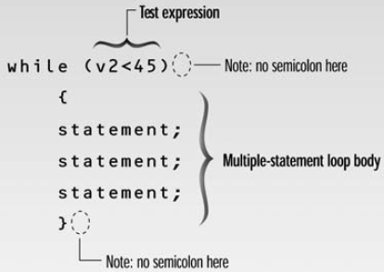
while loop - syntax
Loop body contain
single statement
Loop body contain
Multiple statement

Slide 11
Example: Tracing a while Loop
Initialize count
int count = 0;
while (count < 2)
{
cout << "Welcome to C++!";
count++;
}

Slide 12
Example: Tracing a while Loop
(count < 2) is true
int count = 0;
while (count < 2)
{
cout << "Welcome to C++!";
count++;
}

Slide 13
Example: Tracing a while Loop
int count = 0;
while (count < 2)
{
cout << "Welcome to C++!";
count++;
}
Print “Welcome to C++”

Slide 14
Example: Tracing a while Loop
int count = 0;
while (count < 2)
{
cout << "Welcome to C++!";
count++;
}
Increase count by 1
count is 1 now

Slide 15
Example: Tracing a while Loop
(count < 2) is still true since count is 1
int count = 0;
while (count < 2)
{
cout << "Welcome to C++!";
count++;
}

Slide 16
Example: Tracing a while Loop
int count = 0;
while (count < 2)
{
cout << "Welcome to C++!";
count++;
}
Print “Welcome to C++”

Slide 17
Example: Tracing a while Loop
int count = 0;
while (count < 2)
{
cout << "Welcome to C++!";
count++;
}
Increase count by 1
count is 2 now

Slide 18
Example: Tracing a while Loop
(count < 2) is false since count is 2 now
int count = 0;
while (count < 2)
{
cout << "Welcome to C++!";
count++;
}

Slide 19
Example: Tracing a while Loop
int count = 0;
while (count < 2)
{
cout << "Welcome to C++!";
count++;
}
The loop exits. Execute the next statement after the loop.

Slide 20
(while loop) – Example
Write a program that inputs a value in an integer number from user. For this number the program returns the count for how many times can we divide this number by 2 to get down to 1”.
int count = 0; int num; cin>>num;
//count how many divisions we've done
while (num > 1)
{
num = num / 2;
count++;
}
cout<<“\nWe have to divide: “<<count<<“ times”;

Slide 21
(while loop) – Example
infinite while loops…
while(true)
{
cout<<"\n Infinite loop";
}
while(10)
{
cout<<"\n Infinite loop";
}
while(‘A’)
{
cout<<"\n Infinite loop";
}

Slide 22
(while loop) – Example
while (numEntries = 3) //always true
{
cout <<"working … "; numEntries++;
}
while (numEntries = 0) //always false
{
cout << “never executed… ";
}

Slide 23
do loop

Slide 24
do loop
In while loop if condition is false it is never entered or executed
Sometime, requirements are that the loop should be executed at least once….
For that, we use do loop, that guarantees at least on execution of the loop body

Slide 25
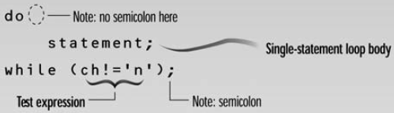
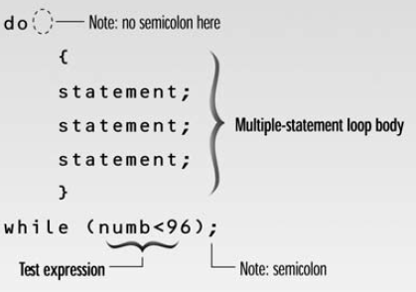
do while loop - Syntax
Loop body contain
single statement
Loop body contain
Multiple statement

Slide 26
do loop – Example1
int main( )
{ int counter, howmuch; cin>>howmuch; counter = 0;
do {
counter++;
cout<<counter<<endl;
} while ( counter < howmuch);
return 0;
}

Slide 27
do loop – Example2
int main( )
{ int num1, num2; char ch; do {
cout<<“\nEnter a number:”;
cin>>num1;
cout<<“\nEnter another number:”;
cin>>num2;
cout<<“\nTheir sum is: “<<num1+num2;
cout<<“\nDo another time (y/n):”;
cin.get(ch);
} while(ch==‘y’);
return 0;
}

Slide 28
break Statement
break statement
Immediate exit from while, for, do/while, (also used in switch)
break immediately ends the loop that contains it.
Common uses:
Escape early from a loop
Skip remainder part of the loop and exit

Slide 29
break Statement - Examples
for (int i=1; i<=5; i++)
{
if (i==3)
break;
cout<<“Hello”;
}
int n;
int EvenSum=0;
while(1)
{
cin>>n;
if(n%2==1)
break;
EvenSum = EvenSum + n;
}

Slide 30
(using break in loops) – Class Exercise 1
Write a program which reads an integer n from the user, and prints square value (n*n) for that number. Whenever ZERO is entered by the user program should terminate by printing “Invalid Value” message.

Slide 31
continue Statement
continue statement
Only ends the current iteration
Skips remainder of loop body (in current iteration)
Proceeds with next iteration of loop
“continue” can only be inside loops (for, while, or do-while). IT CANNOT BE USED IN “switch”

Slide 32
continue Statement - Examples
for (int i=1; i<=5; i++)
{
if (i==3)
continue;
cout<<“Hello”<<i;
}
int n;
int EvenSum=0;
while(1)
{
cin>>n;
if(n%2==1)
continue;
EvenSum = EvenSum + n;
}

Slide 33
(Nested Loops) Nested Repetition Structures

Slide 34
(Nested Loops)
In a nested repetition structure, one loop (inner loop) is placed entirely within another loop (outer loop)
In nested loops any loop (for, while, or do loop) can be placed inside another loop which can be a for, while, or a do loop

Slide 35
(Nested Loops) - Examples
Outer Loop
for (int i=0; i<2; i++) {
for (int j=0; j<2;j++) {
cout<<“\nHello-”<<i<<“:“<<j;
}
}
Inner Loop

Slide 36
(Nested Loops) - Examples
int main()
{
int weeks=3, days_in_week=7;
for (int i = 1; i <= weeks; ++i) {
cout << "Week: " << i << endl;
for (int j = 1; j <= days_in_week; ++j) {
cout << " Day:" << j << endl;
}
}
return 0;
}

Slide 37
(Nested Loops) – Exercise-1
Write a program to print triangle of starts.
*
**
***
****
*****
******
*******
********
*********

Slide 38
(Nested Loops) – Exercise-2
Write a program to print triangle of starts.
*********
********
*******
******
*****
****
***
**
*

Slide 39
(Nested Loops) – Exercise-3
Write a program to print Rectangle based on two triangles (One using + and other using * symbol).
+********
++*******
+++******
++++*****
+++++****
++++++***
+++++++**
++++++++*
+++++++++

Slide 40
(Nested Loops) – Exercise-4
Write a program for a company to calculate total sales for 3 regions. Each region’s sales is entered by user which is then summed in total regional sales. The program keep accepting regional sales until it is not 0. The program prints the final regional sum for three regions and exits.
Example Output:
Total Sales for Region 1: 87645
Total Sales for Region 2: 2312
Total Sales for Region 3: 8874

Slide 41
(for loop) -- Class Exercise-3
- Write a program that asks the user to enter two numbers (multiple of 10): speed1, and speed2 representing speeds in KPH (Kilo meters per Hour). Then the program should convert and show table of speeds in MPH (Miles per Hour) for all the speed values between speed1 and speed2.
MPH = KPH * 0.6214
speed1 and speed2 variables should be multiple of 10. Each table entry (in KPH) should be updated by 5 in each iteration.

Slide 42
References
Credit goes to Dr. Muhammad Aleem for preparation of slides
Text book: Starting out with c++

Slide 43
Thank You ☺

